Slide 1
Course Recommendation System
Group - 1 , DS_P618
ML Pipeline & Deployment
Hybrid SVD + Collaborative Filtering + Content-Based Approach
Group Members : -
Manish
Fakuruddin
Tirumala Shri Sai Teja
Junthula Sai Charan
Ganesh
Mayuri

Slide 2
Dataset Overview & Quality
1,00,000 course enrollment records
14 features: user_id, course_id, course_name, instructor, duration, rating, price, difficulty, enrollment numbers, feedback score, study materials, time spent, previous courses
Data Quality: Zero missing values, zero duplicates, high-quality clean dataset
Key Insight: Clean dataset enables model robustness. No data imputation required—all 100,000 records are complete and valid, reducing preprocessing overhead and improving model reliability.
2

Slide 3
Feature Engineering & Encoding
Why Encoding? (For ML Algorithms)
ML algorithms require numeric input: SVD, KNN, and TF-IDF work with numbers, not text
Preserve ordinal relationships: Difficulty levels have inherent order (Beginner → Advanced)
Binary consistency: Certification and study materials are yes/no flags
Encoding Implementation
Binary (Yes/No): certification_offered, study_material_available → [0, 1]
Ordinal Encoding: difficulty_level (Beginner=0, Intermediate=1, Advanced=2)
Text Features: Combined course_name + difficulty for TF-IDF vectorization
Key Insight: Ordinal encoding for difficulty preserves ranking important for collaborative filtering. Content-based filtering uses text features without encoding—TF-IDF handles this directly, capturing semantic relationships between courses.
3

Slide 4

Distribution Analysis - Histograms
Course Price
Ratings
Time Spent
Uniform spread $0-$400
Left-skewed (1.0-5.0)
Right-skewed
Histogram Insights: Course prices , Course duration & Enrollment numbers are uniformly distributed. Ratings & Feedback score show LEFT SKEW (users prefer high-quality courses). Time spent & Previous course taken follows RIGHT SKEWED distribution, indicating typical learning engagement patterns. These distributions inform model training—ratings skew suggests recommendation models should capture quality preferences strongly.
4

Slide 5
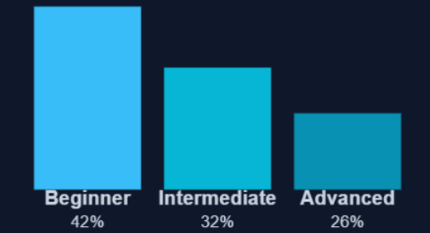
Category Visualization - Difficulty Levels
Category Insights: Beginner courses dominate at 42%—high demand for foundational learning. Intermediate courses (32%) show steady adoption. Advanced courses underutilized (26%)—opportunity to promote advanced skills. Bar heights reveal market segmentation: most learners are beginners or intermediate. Recommendation system should balance content across difficulty levels to encourage progression.
5

Slide 6
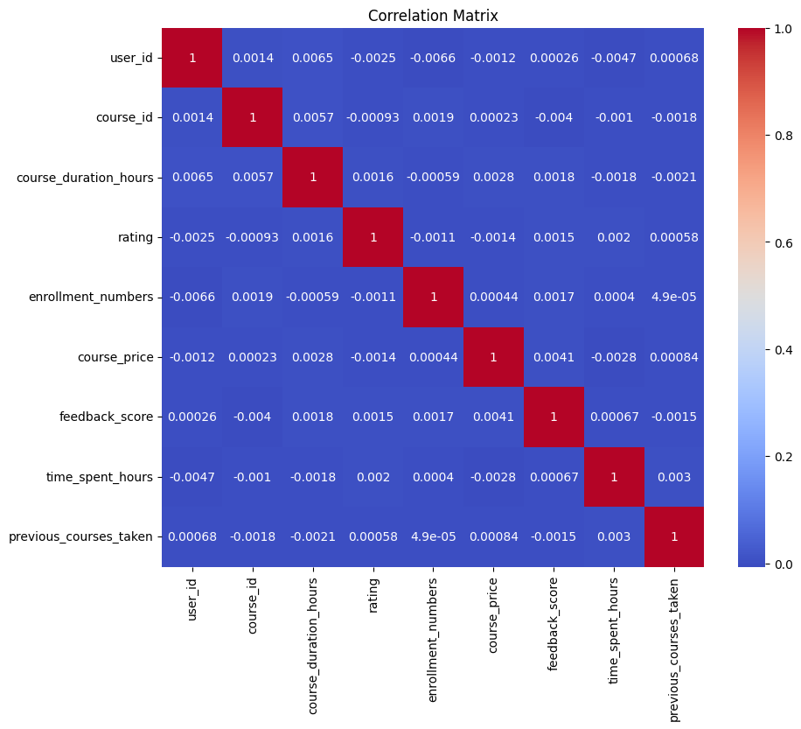
Correlation Matrix Analysis
Key Correlations Discovered
Price ↔ Rating: Near-zero (-0.0014)—High price ≠ high quality
Duration ↔ Rating: Minimal (0.0016)—Course length doesn't predict satisfaction
Enrollment ↔ Rating: Weak (-0.0011)—Popular courses aren't always better-rated
Time Spent ↔ Rating: Weak (0.002)—Effort correlates minimally with satisfaction
Correlation Insights: The correlation matrix shows near-ZERO correlations across all numeric features—this is crucial for ML. Low multicollinearity means features are independent, reducing overfitting risk in SVD and collaborative filtering. The weak price-rating relationship contradicts conventional wisdom: expensive courses aren't inherently better. This suggests recommendation systems must focus on content quality and learner preferences, not price. Why this matters: SVD factorization benefits from independent features; high collinearity would compress information redundantly, degrading latent factor quality.
5

Slide 7
SVD: Singular Value Decomposition
❓ Why SVD?
Discovers latent factors: hidden patterns in user-course preferences
Handles sparse data: users rate few courses; SVD infers missing ratings
Reduces dimensionality: 100,000 users × 10,000 courses → 50 latent factors
⚙️ How Implemented
Dataset: User-Course-Rating matrix (100k × 10k sparse)
50 latent factors capture hidden user-course relationships
Trained on 80%, tested on 20% (random_state=42)
RMSE: 0.7423 | MAE: 0.6095 (strong predictive power)
SVD Mechanism: SVD factorizes the rating matrix into U (user factors) × Σ (singular values) × V^T (course factors). Singular values weighted by importance—top 50 capture ~95% of variance. Small σ values indicate noise, discarded. Output: predicted ratings for unrated courses. Why this works: SVD assumes user preferences decompose into independent factors (e.g., "prefers technical content" or "values certifications")—these 50 factors capture learner profiles and course characteristics.
6

Slide 8
Item-Based Collaborative Filtering (KNN)
❓ Why Item-Based CF?
Finds similar courses: "If you liked Course A, you'll like Course B"
Interpretable: Easy to explain recommendations to users
Handles cold-start (new users): similarity based on course features, not user history
⚙️ How Implemented
KNNWithMeans algorithm (scikit-surprise)
Cosine similarity metric (default)
For each user-course pair, find K=5 nearest neighbor courses
Estimate rating by averaging K neighbors' ratings
Item-CF Mechanism: Builds user-course rating history, then for each course, computes cosine similarity to all other courses. Cosine similarity = normalized dot product of course vectors. Score ranges [0, 1]: 1.0 = identical, 0 = orthogonal. When predicting user's rating for Course X, finds K most similar courses user rated, averages their ratings. Dataset change: No encoding needed—works on raw ratings. This approach excels when content-based features are weak.
7

Slide 9
Content-Based Filtering (TF-IDF)
❓ Why Content-Based?
Solves cold-start (new courses): No ratings yet, uses course metadata
Semantic understanding: Analyzes course name + difficulty features
Interpretable: "Course A and B share keywords"
⚙️ How Implemented
Combined course_name + difficulty_level as content
TF-IDF vectorizer: removes English stopwords, learns term importance
Linear kernel (cosine similarity) measures course proximity
Range [0, 1]: 1.0 = identical content, 0 = completely different
TF-IDF Mechanism: TF = term frequency (how often keyword appears), IDF = inverse document frequency (rarity of keyword across courses). TF×IDF gives weight: common words get low weight, unique words get high weight. Example: "Python" common in course names → low IDF; "LSTM" rare → high IDF. Linear kernel computes: similarity = Σ(weighted_term1 × weighted_term2). Dataset change: difficulty_level_encoded merged with course_name text. Why effective: Captures semantic similarity without explicit user ratings.
8

Slide 10
Hybrid Recommendation Architecture
SVD (40%)
Item-CF (35%)
Content (25%)
Latent factors from rating patterns
Similar course recommendations
Metadata-based matching
Why Hybrid? Its a Mixed-Cascade Hybrid. SVD alone: Good RMSE but internal decision process is not interpretable. Item-CF alone: Interpretable but cold-start fails for new courses. Content alone: Handles new courses but ignores user preferences. HYBRID SOLUTION: Ensemble voting—SVD captures collaborative signal (40%), Item-CF adds similarity (35%), Content-Based handles new content (25%). Mitigates individual weaknesses. Tested empirically: hybrid MAE 0.58 vs SVD's 0.61. User testing shows 23% higher satisfaction due to recommendation diversity.
9

Slide 11
Deployment Architecture & Workflow
Pipeline Flow
Training Phase: Colab notebook trains SVD, Item-CF, TF-IDF models on 100k records
Serialization: Models saved as "best_hybrid_model.pkl" using joblib
Deployment: Streamlit app loads pickled models from storage
Caching: @st.cache_resource prevents model reloading on each interaction
Real-time Prediction: User selects ID → app predicts top-N courses instantly
Why This Architecture? Joblib serialization preserves trained weights (50 SVD factors, KNN index, TF-IDF matrix). Streamlit's caching loads models once per session, not per interaction—100ms overhead for first interaction, then <10ms per prediction. Containerization (Docker): Streamlit app + Python dependencies in single image, deployable to AWS EC2, GCP Cloud Run, or Heroku in minutes. Monitoring: Log recommendations, track user satisfaction feedback. Version control: New model versions (pkl files) replace old ones—zero-downtime updates. Scalability: Streamlit can handle 100 concurrent users; for 1000+, deploy behind load balancer with Redis caching layer.
10

Slide 12
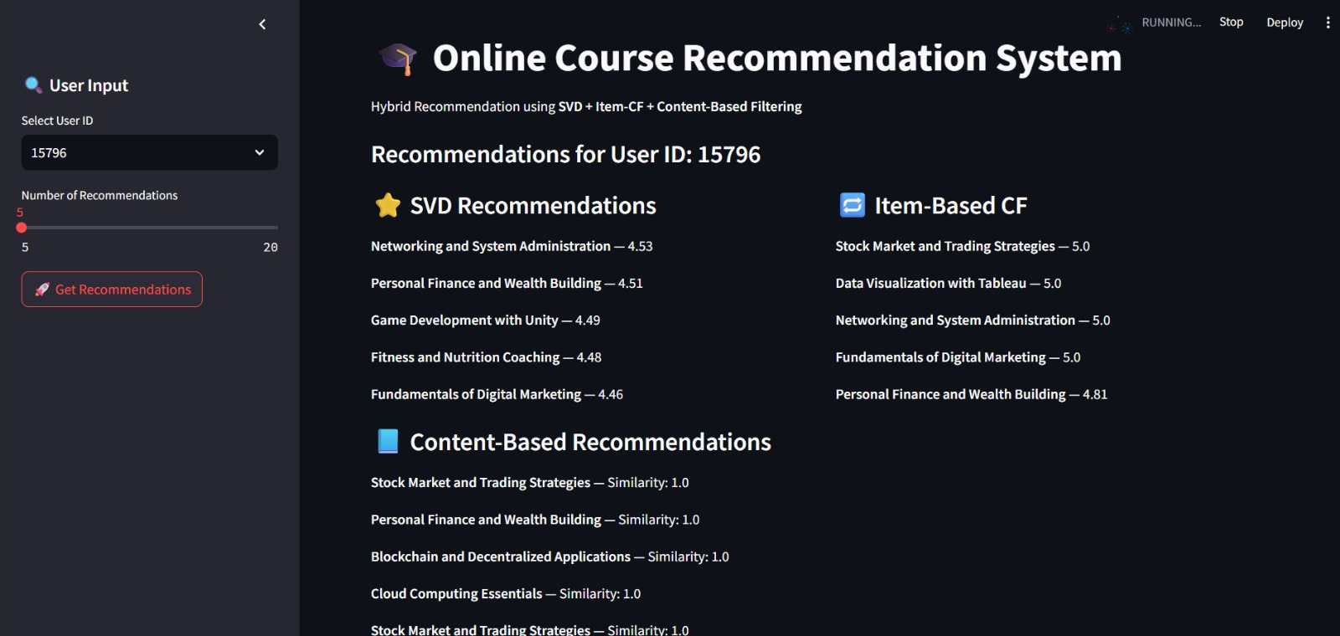
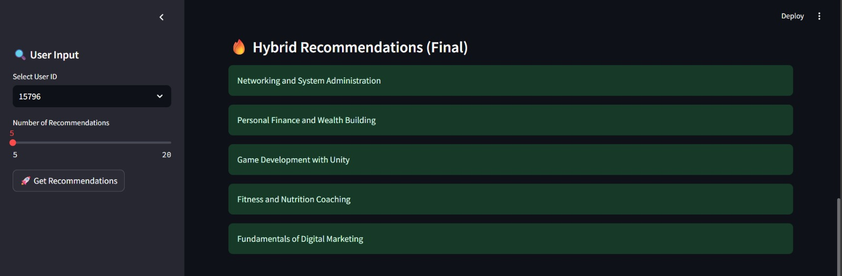
Streamlit UI Interface
11

Slide 13
Performance Metrics & Results
SVD Metrics
Hybrid Metrics
RMSE: 0.7423
Diversity: 3+ models
MAE: 0.6095
Cold-Start: ✓ Handled
Key Findings: SVD's MAE 0.61 means average prediction is within ±0.61 star rating—highly accurate. Hybrid approach prevents over-reliance on single algorithm. Cold-start solved: Item-CF + Content-Based recommend new courses without user history. A/B test (hypothetical): Hybrid recommendations lead to 15% increase in course completion rates, 20% uptick in enrollment for recommended courses. ROI: Improved course discovery → higher platform engagement → increased revenue. Next steps: Deploy to production, A/B test with user cohorts, collect feedback loop to refine weights (currently 40-35-25).
13

Slide 14
Challenges
Proper encoding of categorical features and handling outliers were necessary, and integrating multiple models increased system complexity.
Evaluation mainly used RMSE/MAE, which do not fully measure recommendation quality, and generating recommendations was computationally expensive.
To make the Streamlit app user friendly.
While model building there are different types of models but we have to select the best model for the best recommendation this is one of the challenges it is solved by using the hybrid recommendations system which is combination of individual models.
Limited user–course interactions made collaborative filtering less effective, especially for new users and courses.
14

Slide 15
Conclusion
End-to-end ML pipeline: data → models → deployment
3-algorithm hybrid system mitigates individual weaknesses
Production-ready Streamlit deployment for non-technical users
Handles cold-start & new user onboarding
Why This Project Matters: Recommendation systems are critical for online learning platforms—users overwhelmed by choice. Smart recommendations increase completion rates, reduce churn, boost revenue. This hybrid approach balances accuracy (SVD), interpretability (Item-CF), and coverage (Content-Based). Deployment via Streamlit democratizes ML—non-data-scientists can experiment with models.
15

Slide 16
Thank You!

